Slide 1
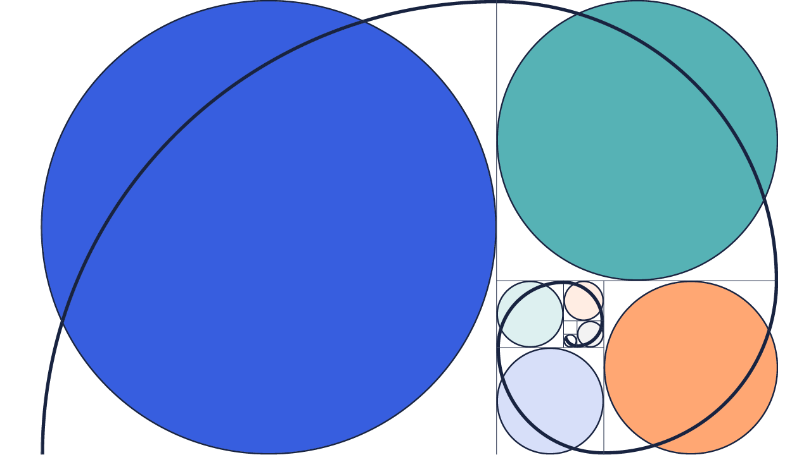
Fibonacci Sequence Presentation
Muhmmad Zunair Khalid
Syed Zain Ali Kazmi
Waize Arif
Muhammad Asif
Muhammad Jazim Iqbal
Moiz ur Rehman

Slide 2
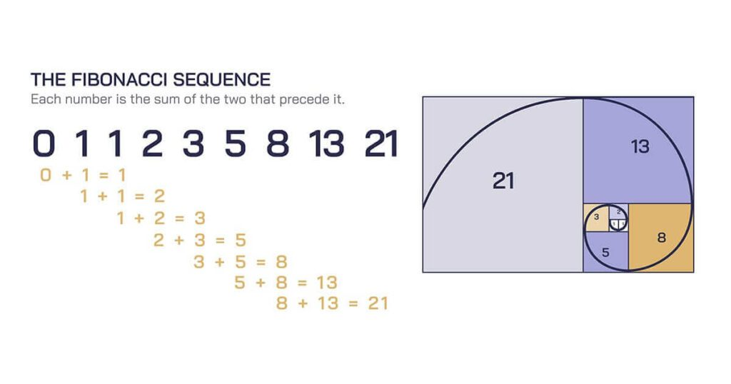
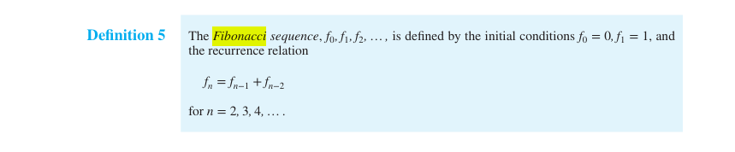
Introduction to the Fibonacci Sequence
The Fibonacci sequence is a series of numbers where each number (known as a Fibonacci number) is the sum of the two preceding ones. It typically starts with 0 and 1 or 0 and 0.
The sequence goes:
0,1,1,2,3,5,8,13,21,34,55,...
Formula:-
Fn = Fn-1 + Fn-2
Fn-1 = the previous term;
Fn-2 = the term before that;
Example:- 5 = 3 + 2

Slide 3

Historical Background
The Sanskrit grammarian 'Pingala' mentioned a sequence resembling Fibonacci's in texts dating back to the 5th century BC and the 3rd century AD.

Slide 4
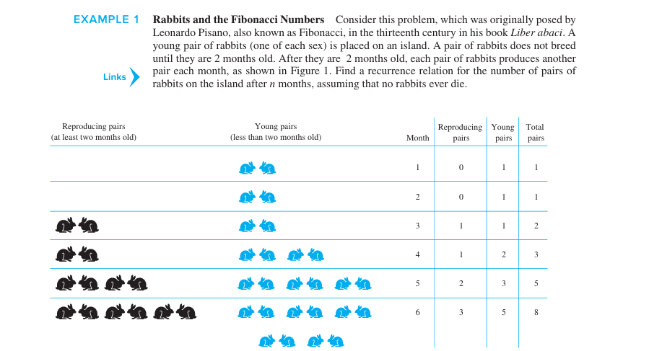
Rabbit Population Problem
Denote by fn the number of pairs of rabbits after n months. We will show that fn, n =1,2,3,…, are the terms of the Fibonacci sequence.
The rabbit population can be modeled using a recurrence relation. At the end of the first month, the number of pairs of rabbits on the island is f1 = 1. Because this pair does not breed during the second month, f2 = 1 also. To find the number of pairs after n months, add the number on the island the previous month, fn−1, and the number of newborn pairs, which equals fn−2, because each newborn pair comes from a pair at least 2 months old.
Consequently, the sequence {fn} satisfies the recurrence relation
fn = fn−1 + fn−2
for n ≥ 3together with the initial conditions f1 = 1 and f2 = 1. Because this recurrence relation and the initial conditions uniquely determine this sequence, the number of pairs of rabbits on the island after n months is given by the nth Fibonacci number

